Slide 1
Team UNO Iteration 1
Team leader Eric taylor
Members noah lin and sierra reed

Slide 2
Iteration Goals
Develop Design for our Acade Dream Sub Game (design document)
Provide UI for Sub Game (Game Start, game score, game dash)
Provide UI for Arcade Dream (Settings, arcade play, user)
Layout of Arcade(Design Doc)

Slide 3
Tickets Assigned
- #105 High Score UI
 | Assigned: Noah
 | Time: 2-3 days
 | - #127 Add menu music from Team 3
 | Assigned: Noah
 | Time: 1 minute
 | - #91 Create UI for login
 | Assigned: Noah
 | Time: 2 days
 | - #22 Make Design Doc
 | Assigned: Noah, Eric
 | Time: n/a
 | - #39 Arcade Game UI
 | Assigned: Noah
 | Time: 2 days

Slide 4
Cont.
- #108 Setting UI
 | Assigned: Sierra
 | Time: 1 day
 | - #120 Start Screen UI
 | Assigned: Noah
 | Time: 30 minutes
 | - #121 Victory UI
 | Assigned: Noah
 | Time: 30 minutes
 | - #122 Level Clear UI
 | Assigned: Noah
 | Time: 30 minutes
 | - #123 Highscore UI
 | Assigned: Noah
 | Time: 30 minutes

Slide 5
Cont.
- #124 Gameover UI
 | Assigned: Noah
 | Time: 30 minutes
 | - #125 Game UI
 | Assigned: Noah
 | Time: 30 minutes
 | - #126 Saving Highscore UI
 | Assigned: Noah
 | Time: 30 minutes
 | - #64 Level Planning of Space Shooter
 | Assigned: Eric
 | Time: 1-2 Weeks
 | - #66 Xeonic Fleet UI
 | Assigned: Eric
 | Time: 1 week
 | - #67 Xeonic Fleet Design Document
 | Assigned: Eric
 | Time: 1-2 weeks

Slide 6
Tickets Remaining
-#38 Create UI for joining lobby
 | -#75 Make overarching storyline
 | -#93 Chat system ui
 | -#106 waitng for players ui
 | -#109 new high score achivement ui

Slide 7
Risk doc
https://github.com/ksu-cs-robotics/fall-2019-gdp-main-project-arcadedream/blob/master/doc/Team1/9-25%20Iteration%20risk%20of%20team%20UNO

Slide 8
Issues
Commit issues (Setting UI-week 2 sept 16)
General code errors (UI week 2-3)
Integration delay (week 3 sept 25-27)

Slide 9
Work
Design Docs:
https://docs.google.com/document/d/1Fh1FsN2_J-OcjyJvD1ss-3hdCnPutHxBKkPFkc85DL4/edit#heading=h.54piadpum7p7
https://github.com/ksu-cs-robotics/fall-2019-gdp-main-project-arcadedream/blob/team1-1/doc/ArcadeGame1/Xeonic%20Fleet%20Design%20Document.docx

Slide 10
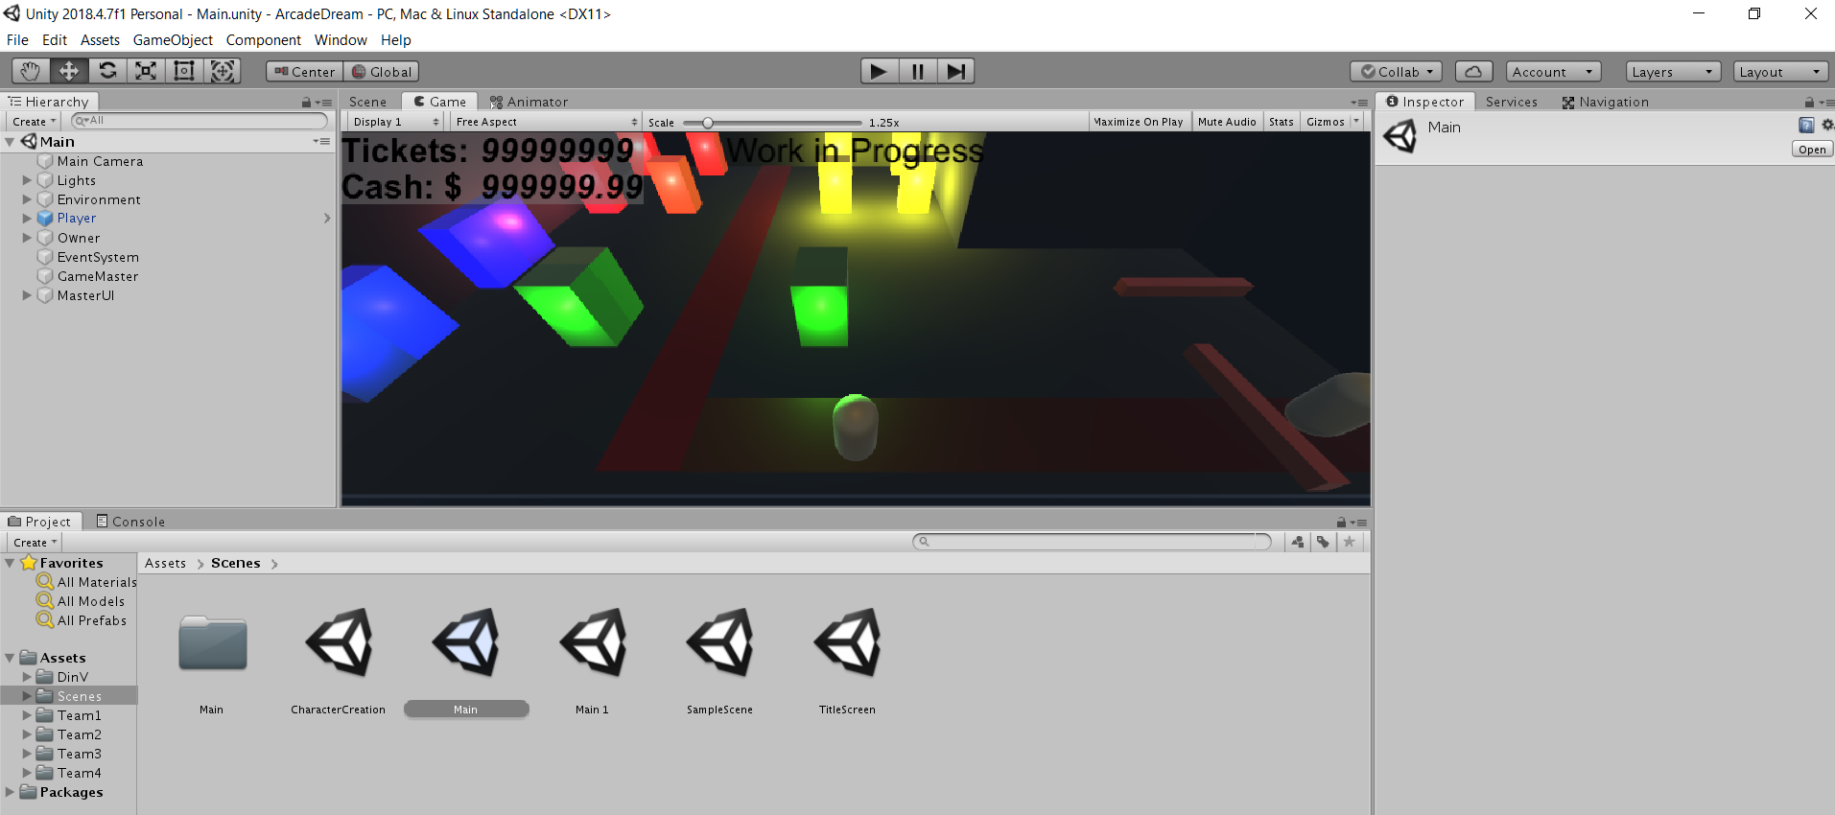
cont

Slide 11
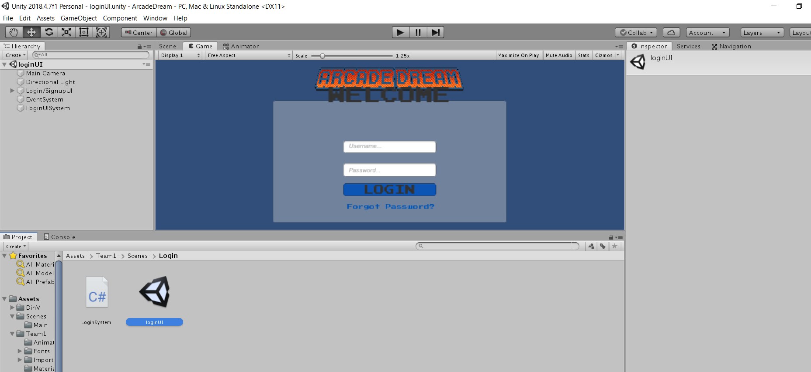
cont

Slide 12
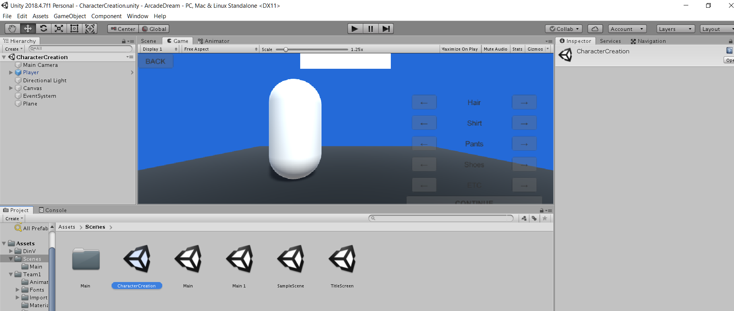
cont

Slide 13
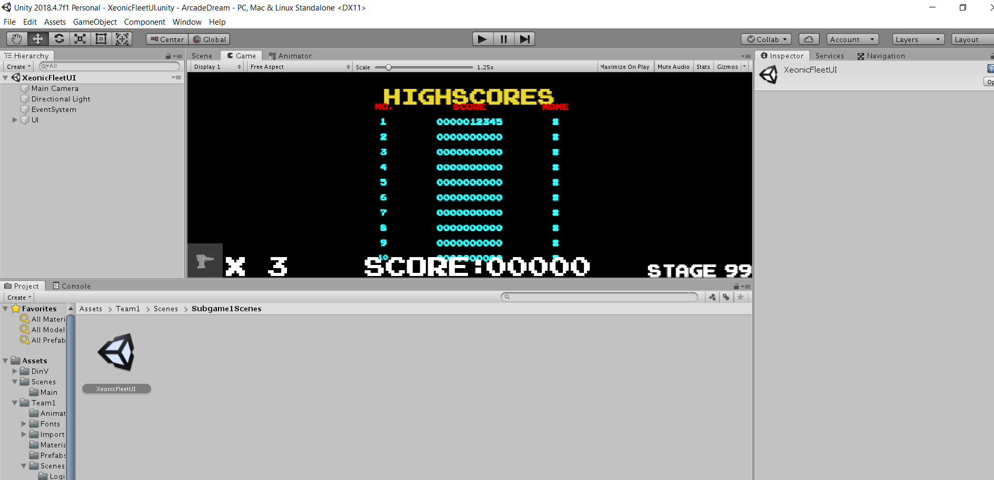
cont

Slide 14
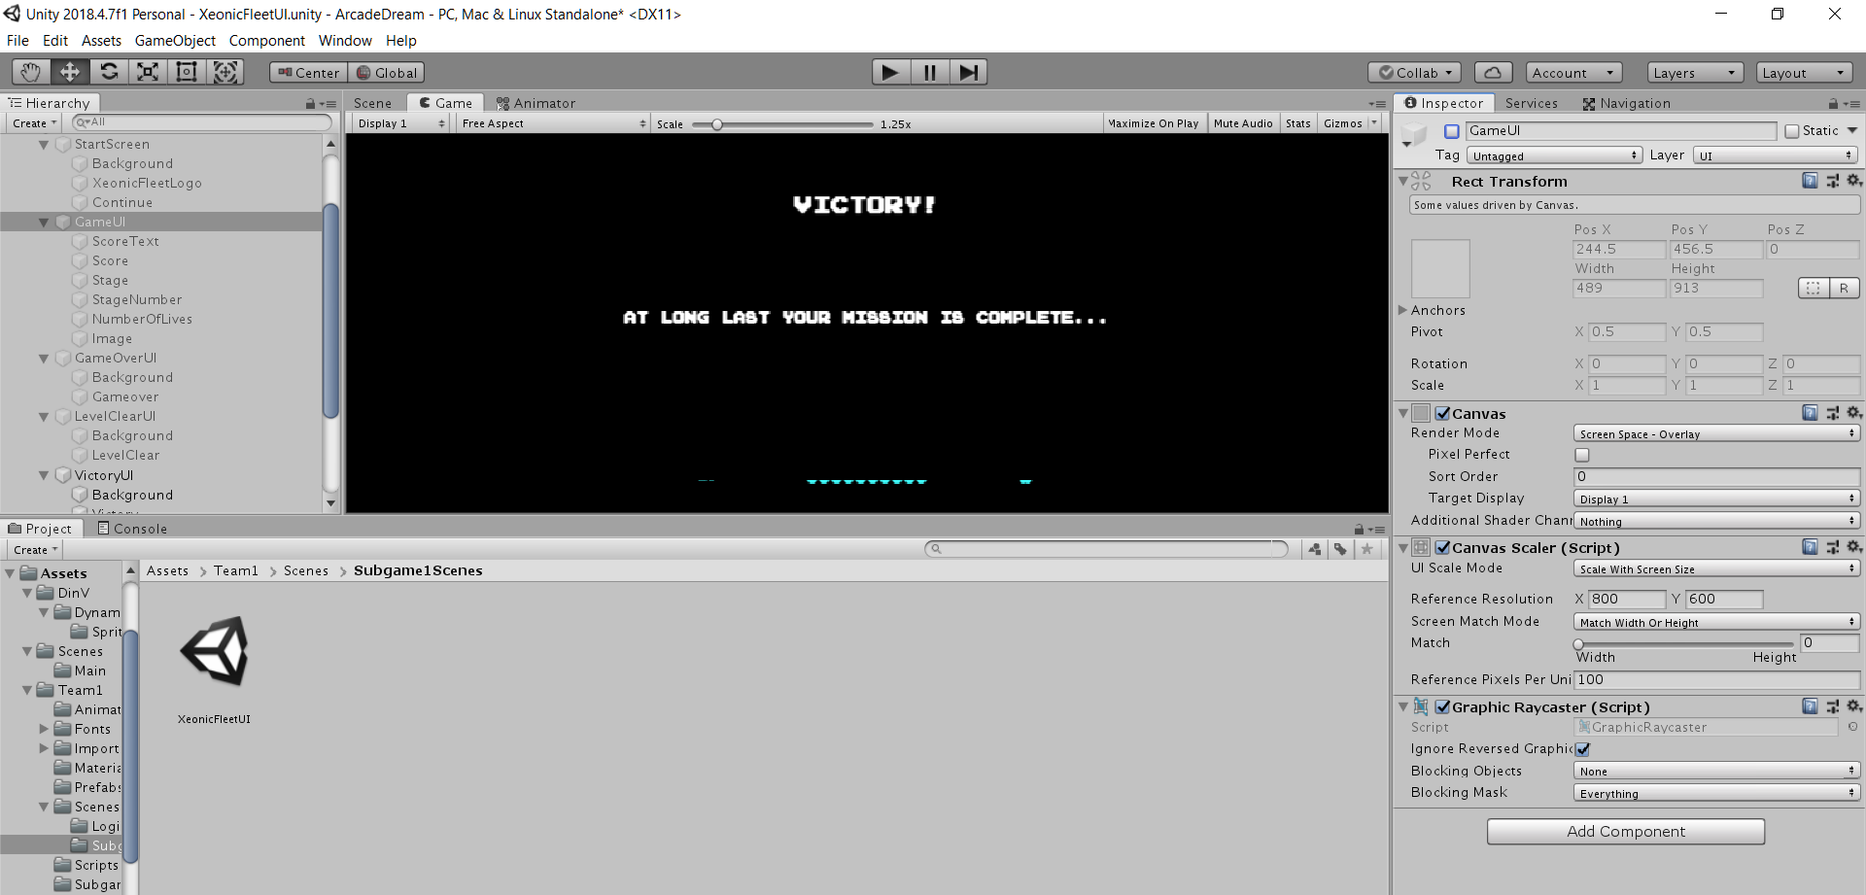
cont

Slide 15
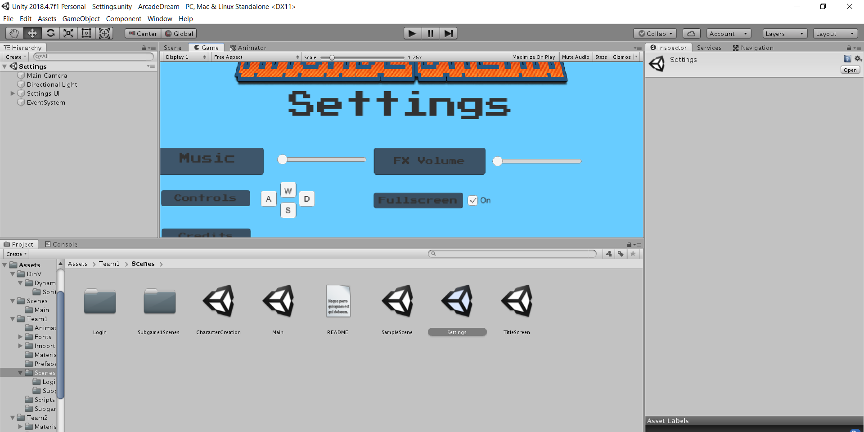
cont

Slide 16
Additional Questions
Consult our github repository:
https://github.com/ksu-cs-robotics/fall-2019-gdp-main-project-arcadedream/tree/team1-1

